Slide 1

Introduction to AI
Group 14:
Team Members :
Shivam Kumar (202401100300233)
Shivani Yadav (202401100300235)
Somya Mishra (202401100300250)
Yuvraj Singh Taniya (202401100300292)
Year & Section:
AI - D (1st Year)

Slide 2

Diabetic Analysis :
An Overview
Problem Statement
Methodology
References
Introduction
Output/Result

Slide 3

Problem
Statement
Diabetes Prediction
Create a classification model to predict the likelihood of diabetes based on health
data. Visualize model accuracy.

Slide 4
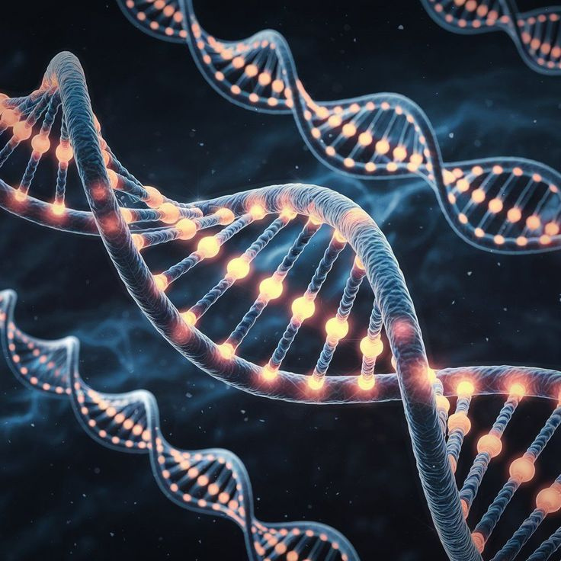
Introduction
Problem Statement : Explained
We are working with a binary classification problem where the goal is to predict whether a patient has diabetes or not, based on various health indicators. The dataset is the famous Pima Indians Diabetes Dataset, which includes the following features:
Pregnancies: Number of times pregnant
Glucose: Plasma glucose concentration
Blood Pressure: Diastolic blood pressure (mm Hg)
Skin Thickness: Triceps skinfold thickness (mm)
Insulin: 2-Hour serum insulin (mu U/ml)
BMI: Body mass index (weight in kg/(height in m)^2)
Diabetes Pedigree Function: A function that scores the likelihood of diabetes based on family history
Age: Age in years
Outcome: Target variable (0 = no diabetes, 1 = diabetes)

Slide 5

Methodology
Data Loading & Exploration:
Data Cleaning:
The dataset was uploaded in Google Colab and examined using basic statistics and info commands to understand its structure and identify anomalies.
Zero values in key columns (Glucose, BloodPressure, SkinThickness, Insulin, BMI) were treated as missing and replaced with the median using imputation.
Visualization:
Modeling with KNN:
Histograms and a correlation heatmap were created to understand feature distributions and relationships. The outcome variable's class balance was also visualized.
A K-Nearest Neighbors classifier (k=5) was trained using an 80-20 train-test split.
Evaluation:
Model performance was assessed using accuracy, a classification report, and a confusion matrix, all supported with visualizations.

Slide 6

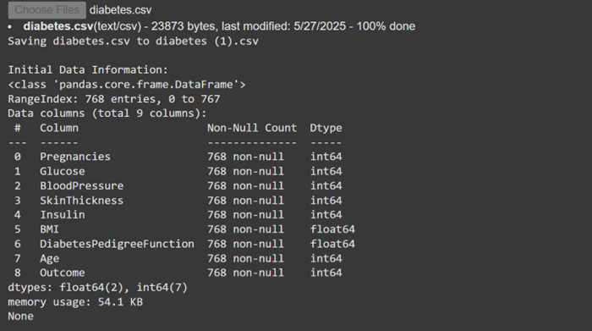
Result (performance metrics)

Slide 7
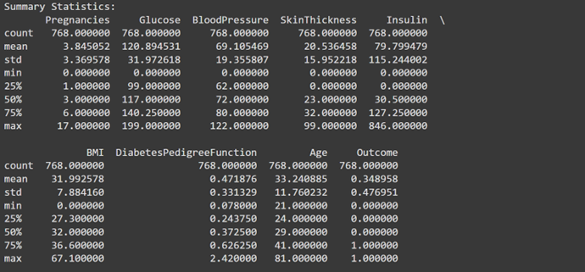
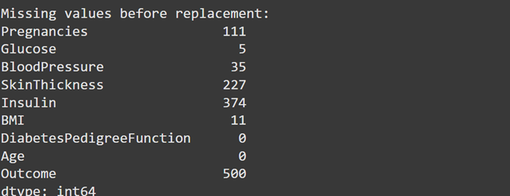

Slide 8
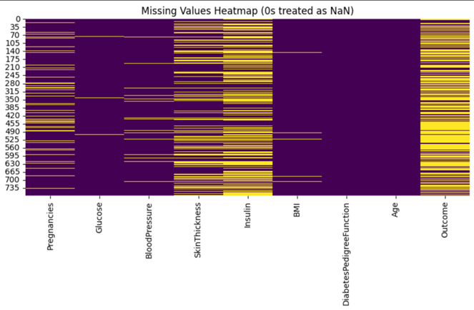
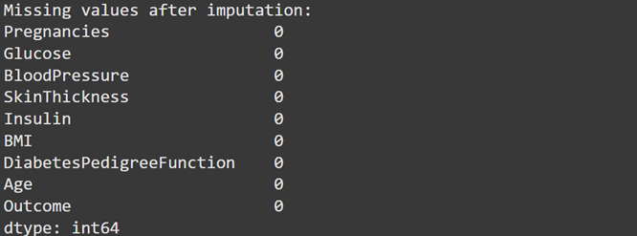

Slide 9
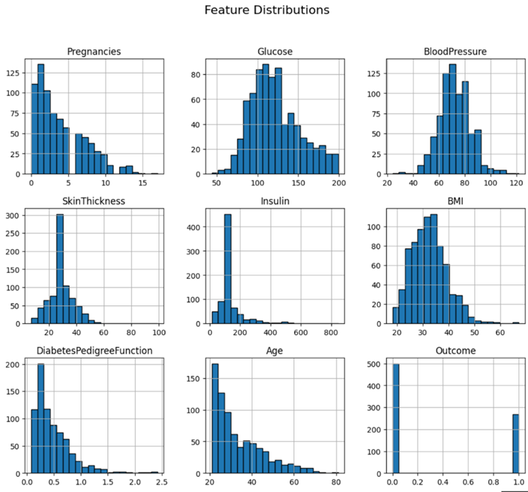
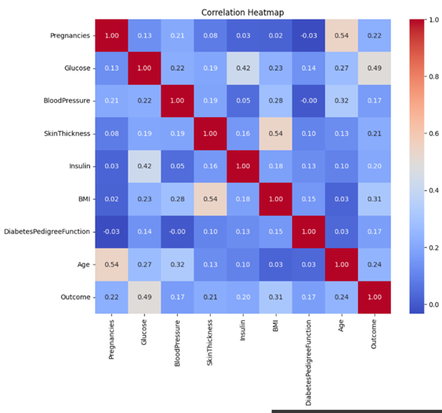

Slide 10
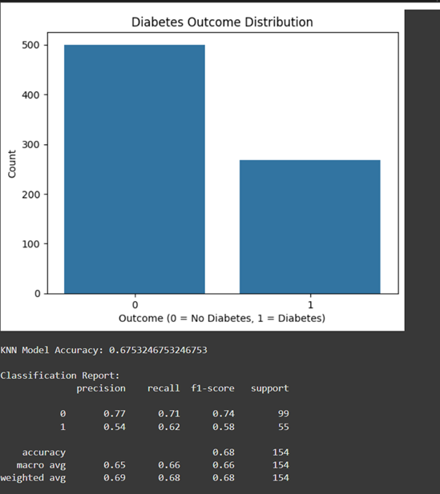
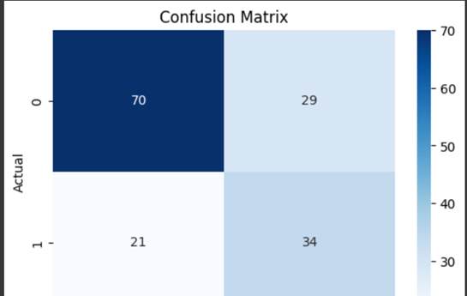

Slide 11
References :
Dataset:
This project uses the Pima Indians Diabetes Dataset, originally provided by the National Institute of Diabetes and Digestive and Kidney Diseases. The dataset is publicly available on the UCI Machine Learning Repository.
Libraries & Tools:
Pandas and NumPy for data manipulation
Matplotlib and Seaborn for visualization
Scikit-learn for preprocessing, modeling, and evaluation
Google Colab for cloud-based execution environment

